Slide 1

Parfait Fit
Supervised by:
Dr. Cherry Ahmed
TA. Maya
Implemented by |  | Impl
Alaa Mahmoud | Joseph Diaa | Rana Ihab | Mariam Amr | Norhan Abdelkader
20190105 | 20190155 | 20190207 | 20190520 | 20190600
Graduation Project
Academic Year 2022-2023
Midyear Presentation

Slide 2
AGENDA
01
02
03
Project Idea
Problem Significance
Project Specifications
04
05
Time Plan
Conclusion

Slide 3
01
Project Idea

Slide 4
Introduction
Idea
A place for brands to display their products.
Customers’ own fashion stylist.
Parfait Fit offers for customers to:
Form outfits from items displayed by brands or items uploaded of their clothes.
Check if that outfit matches.
Domain Of Interest
Fashion through the use of artificial intelligence

Slide 5
02
Problem Significance

Slide 6
Problem Statement
People find it hard to make sure that their outfit is compatible.
Not all people can ask others for their opinion.
Trying to buy a new item that completes an outfit is hard.

Slide 7
Why? (Based on a survey we made)
Difficulty in choosing an outfit
How helpful is an app that checks the outfit?
Yes
71%
No
29%
Percentage of the Problem Occuring
Yes
63%
No
37%

Slide 8
Why?
Percentage of buying from different brands
Brands in one app is convenient?
Yes
95%
Yes
93%
No
5%
No
7%

Slide 9
How?
Parfait Fit will offer solutions for these difficulties
Check if an outfit is compatible.
Recommend a piece that is compatible to complete the outfit.
Exposure to larger audience for providers.
Providing 2 interfaces
Web application for admin and provider.
Mobile application for customers.

Slide 10
How?
Machine Learning:
CNN
NN
Building machine learning models
1) Compatibility Prediction.
Feature Extraction
Full Outfit Compatibility Prediction
2) Recommendation.
Dataset
We will use cleaned and filtered version from Polyvore Dataset.
Original data contains about 21K outfits made by expertise.
Technologies
Flutter for front-end.
Django REST Framework for back-end.
Redis for cache.
PostegreSQL for database.

Slide 11
How?
Compatibility Prediction
Pairwise
Scores
Outfit
Score
Features
Full Outfit Compatibility Prediction
Features Extraction
Model
[CNN]
[NN]
Pairwise Compatibility Measurement Layer
Outfit

Slide 12
How?
Recommendation Model
List of N items
Generates
Compatibility
Prediction
Items Generation
Subset from products
Current
Outfit
List of N
Outfit
Scores
Generated outfit per item
Recommend
Category
Shoes
Top K Compatible
Items

Slide 13

Previous Solutions
Parfait Fit
Wideeyes.ai
Vue.ai
Lookastic
Free
Form outfits based on users’ uploaded items
Check outfit Compatibility
Recommends based on given outfit
Multiple brands
Visual Search
Personalized Recommendation
Product tagging
Style advisor
Product tagging
Image moderation
Brands add their theme
Theme based outfit recommendation
Fitting room
Free
Recommends items that matches a product
Recommends based on user’s interest
No Auto-tagging
No image moderation
No visual search
Requires requesting a demo
One brand
Do not check compatibility
No consideration of customers’ items
Requires requesting a demo
One brand
Do not check compatibility
No consideration of customers’ items
One brand
Do not check compatibility
No consideration of customers’ items

Slide 14
03
Project Specifications

Slide 15
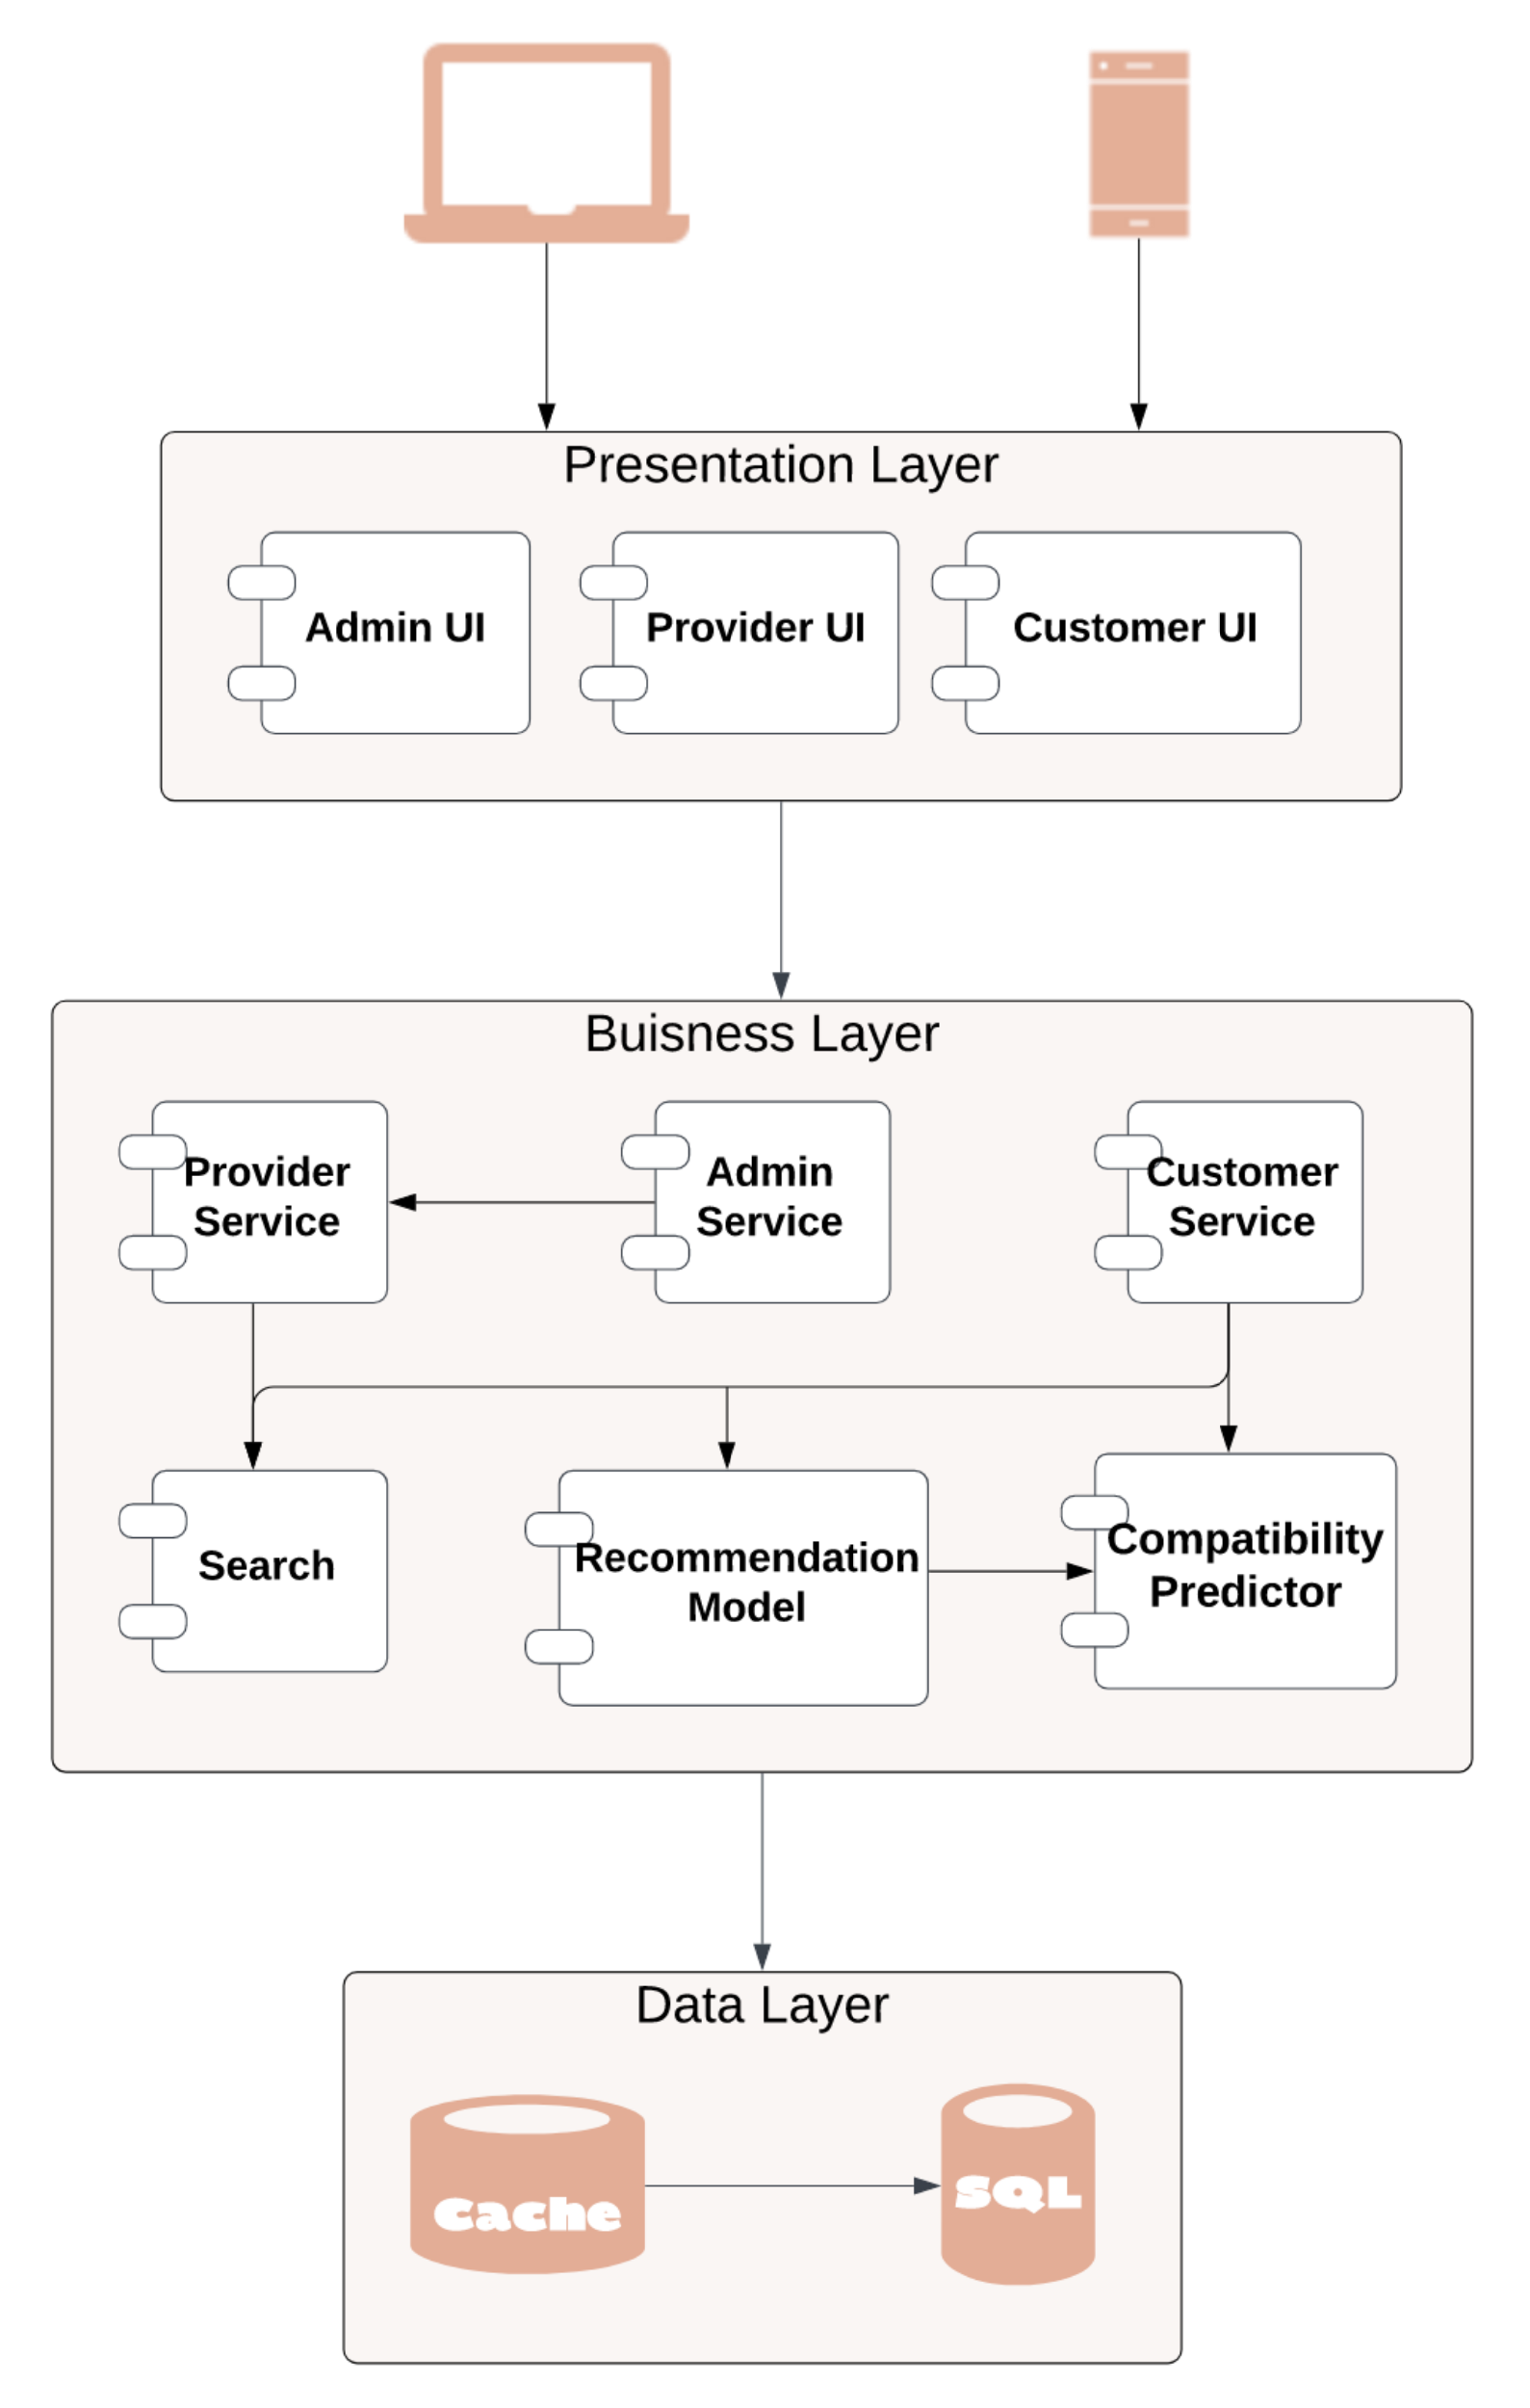
System Architecture
Layered architecture
Layers?
Presentation
Business
Database/persistence
Why?
Ease of development
Reduced dependency
Testing is easier

Slide 16
Stakeholders
Analyze end users (based on a survey we made)
Frequency of using the app by age
Frequency of using the app by gender

Slide 17
Stakeholders
CUSTOMERS
ADMIN
End user
Females
Above 18
Needs fashion advice
End user
Responsible for the system(verify brands)
BRANDS/PROVIDERS
DEVELOPERS
End user
Shop owners
Uploads their products
Collect data
Implement
Test
Maintain

Slide 18
Functional Requirements
FOR CUSTOMERS
Search by text
Upload image of piece of clothes to outfit list
Get recommendation of clothing item
Check most liked items
01
02
03
04
05
06
07
08
View products
Add items to outfit list
Like/unlike items
Check outfit compatibility

Slide 19
Functional Requirements
FOR PROVIDER
FOR ADMIN
01
Upload products
01
View provider
02
Delete products
02
Verify provider
03
View products
03
Suspend provider
04
Filter products
05
Search products

Slide 20
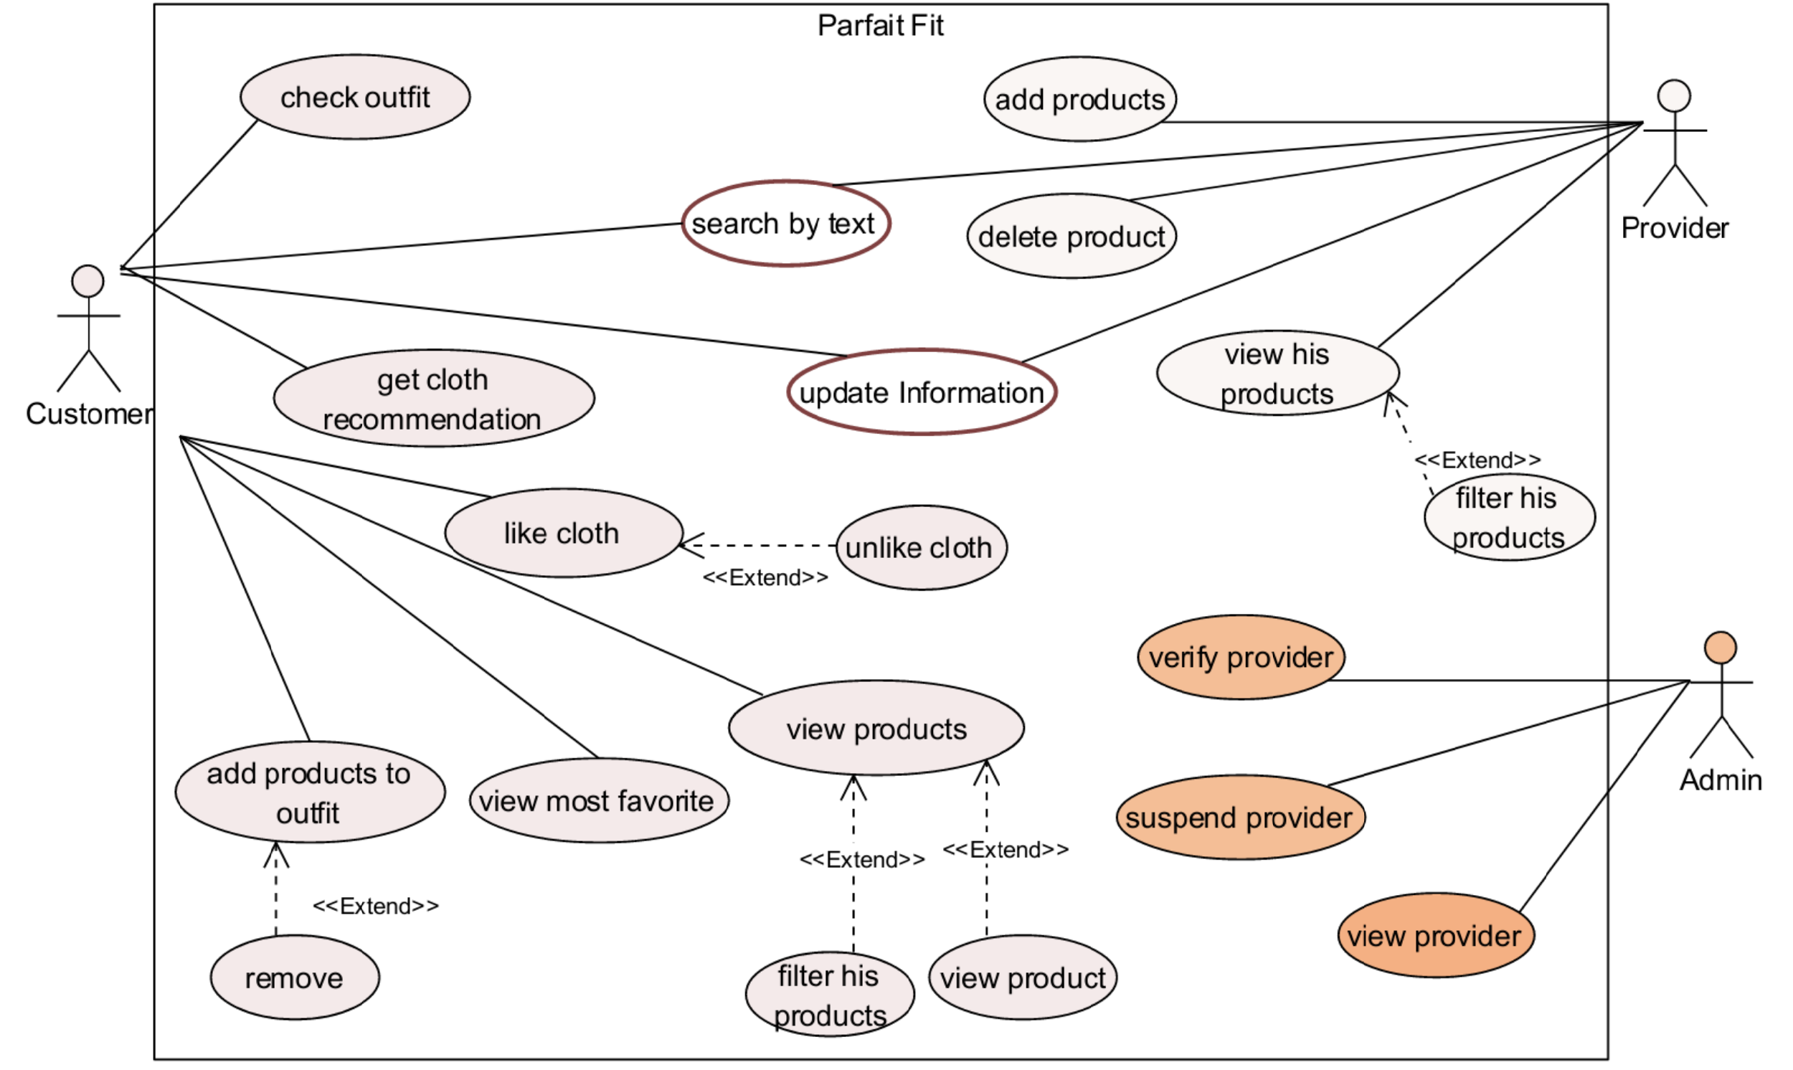
Use Case Diagram

Slide 21

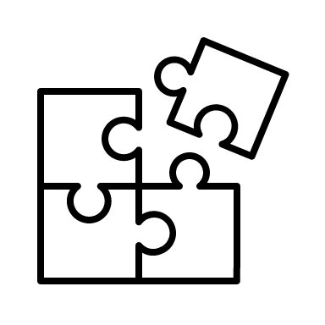
Non Functional Requirements
USABILITY
PERFORMANCE
Easy to use
Simple
Clear
Add instructions
Response time low
Use Redis
SECURITY
EXTENSIBILITY
Make use of django security
Easy to add features
Easy to maintain

Slide 22
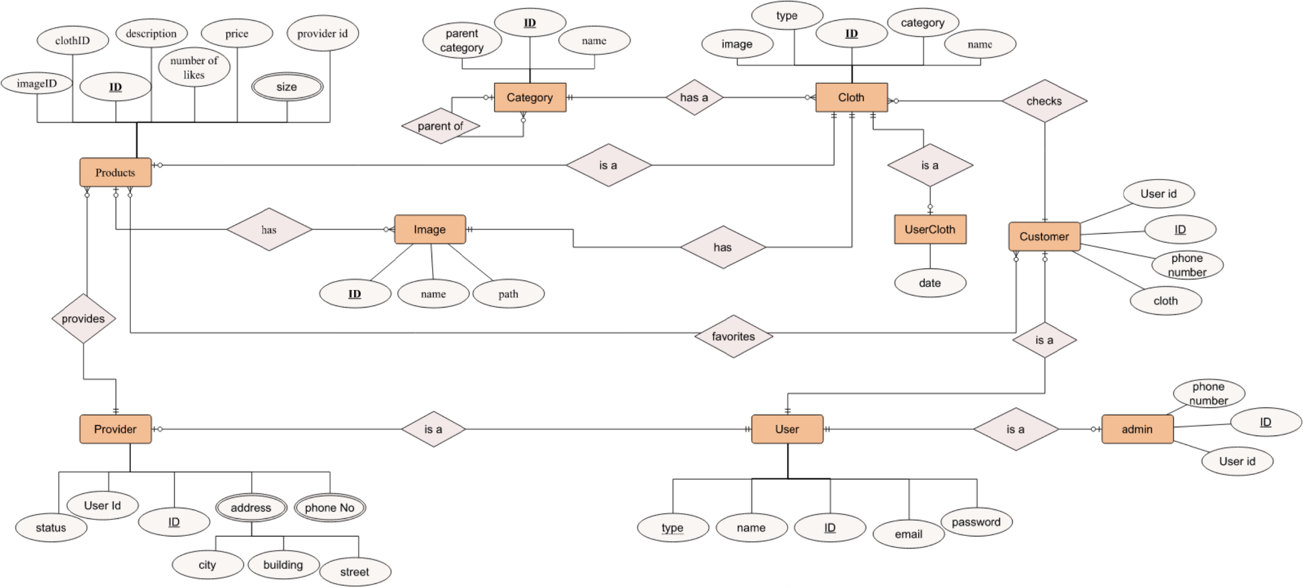
ERD Model

Slide 23
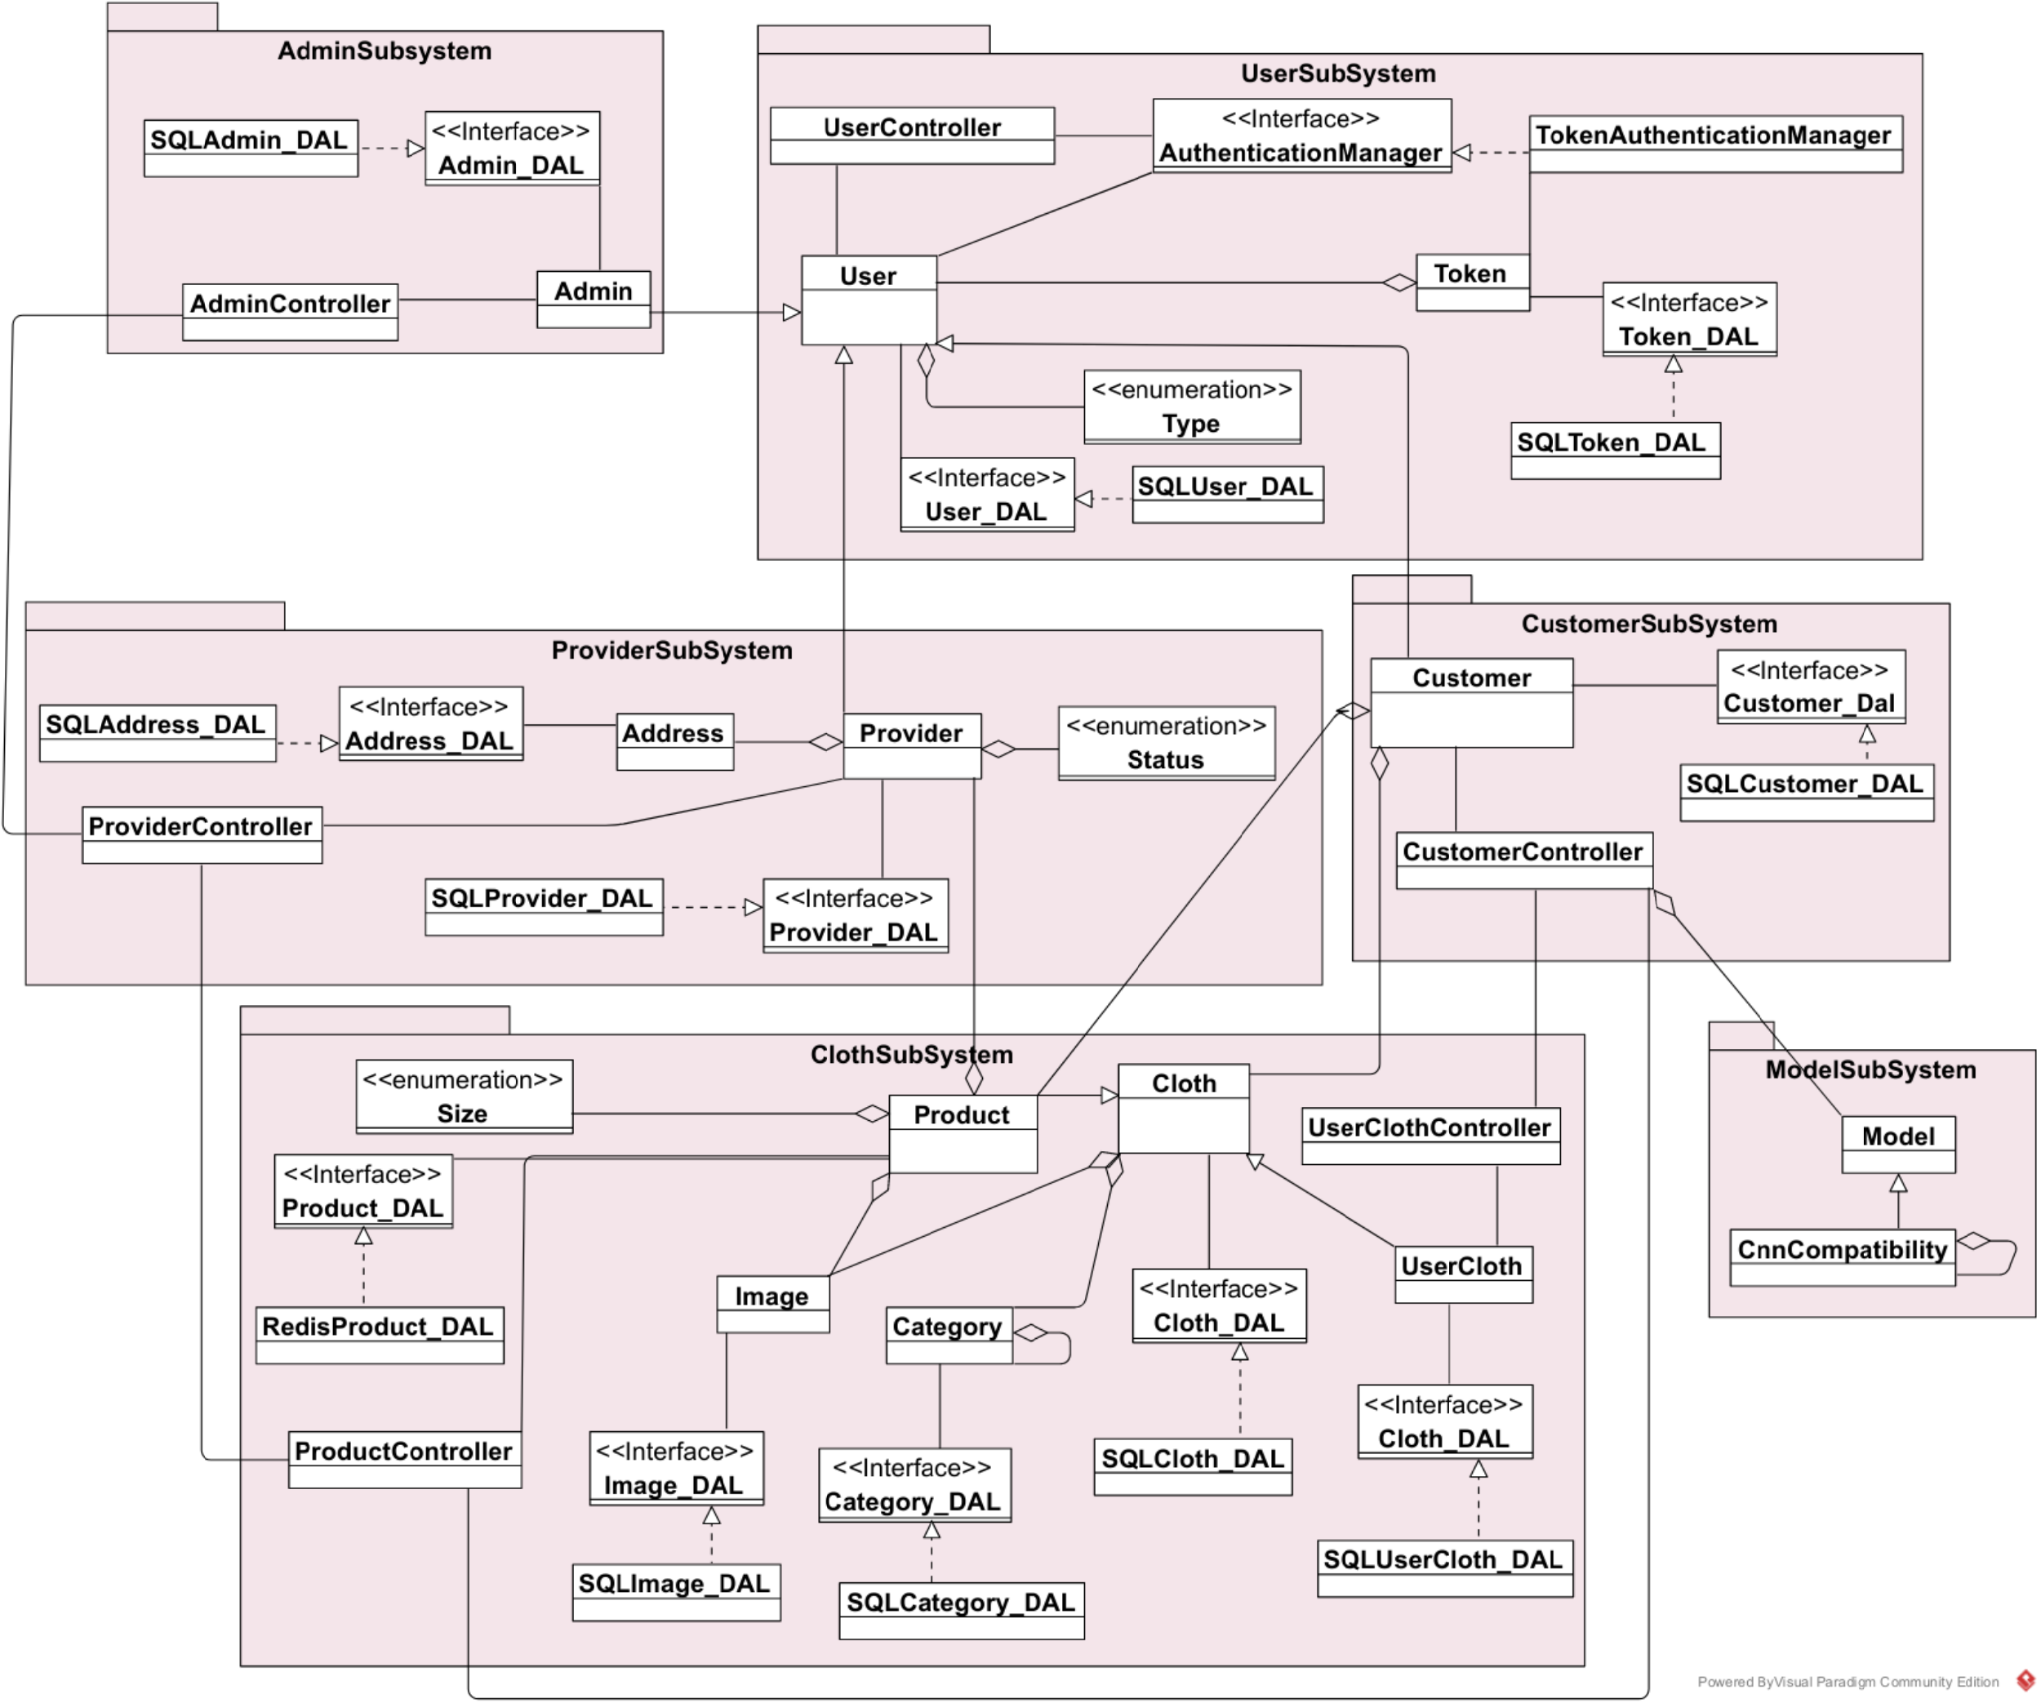
Class Diagram

Slide 24
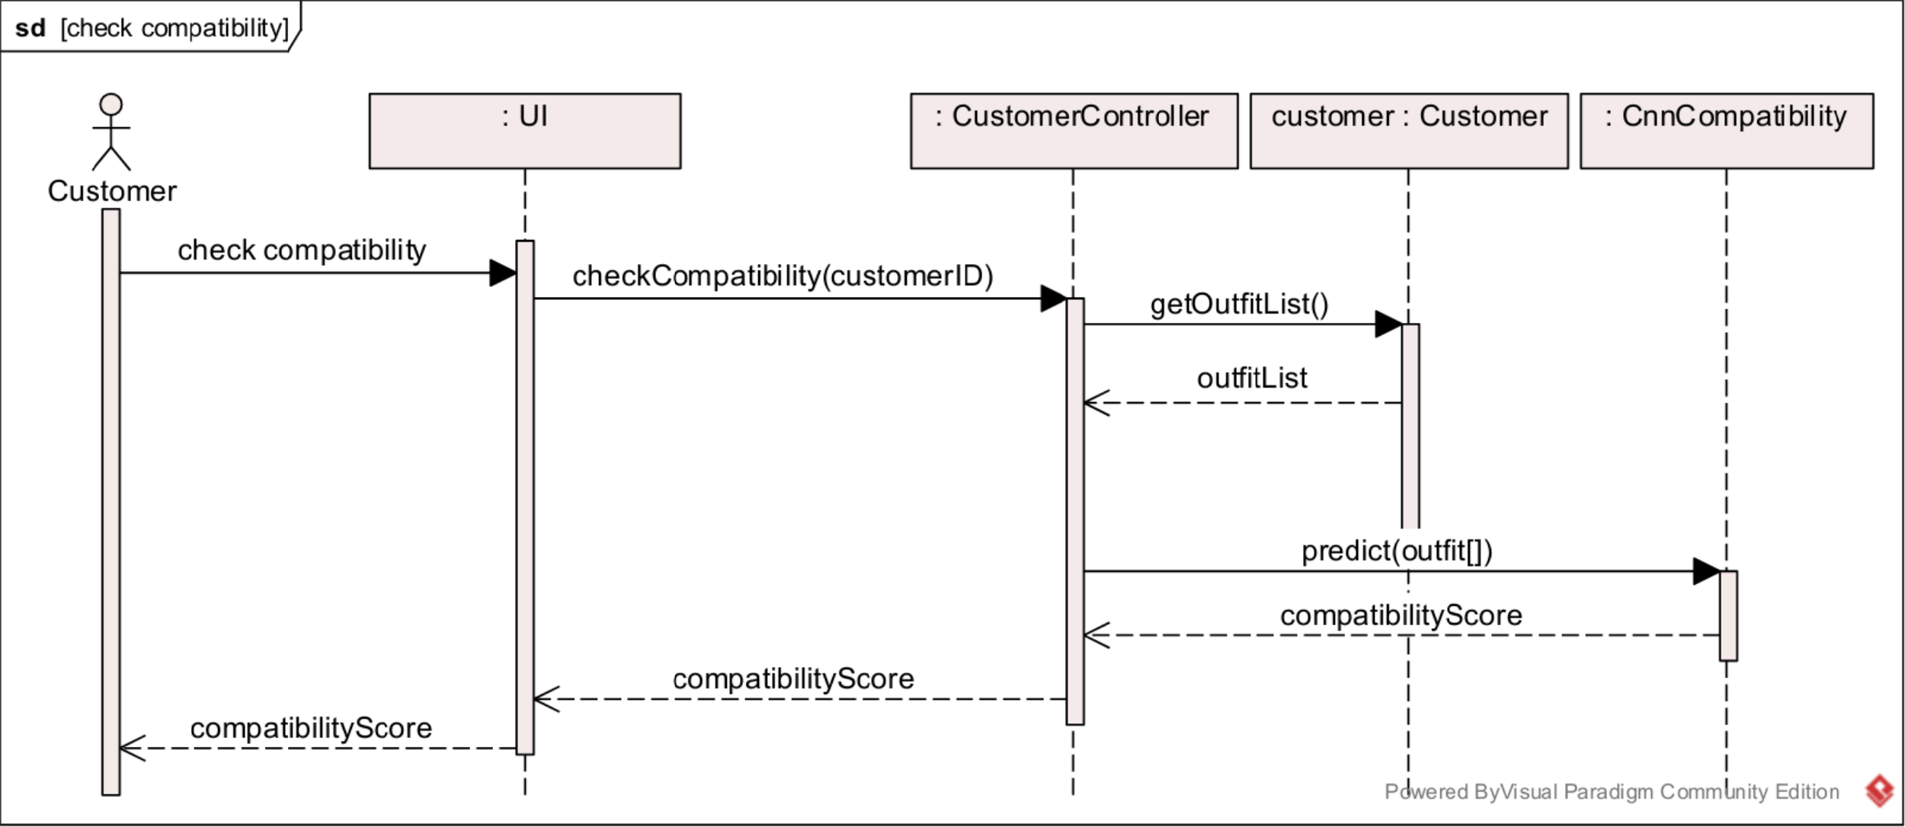
Sequence Diagram (Check Compatibility)

Slide 25
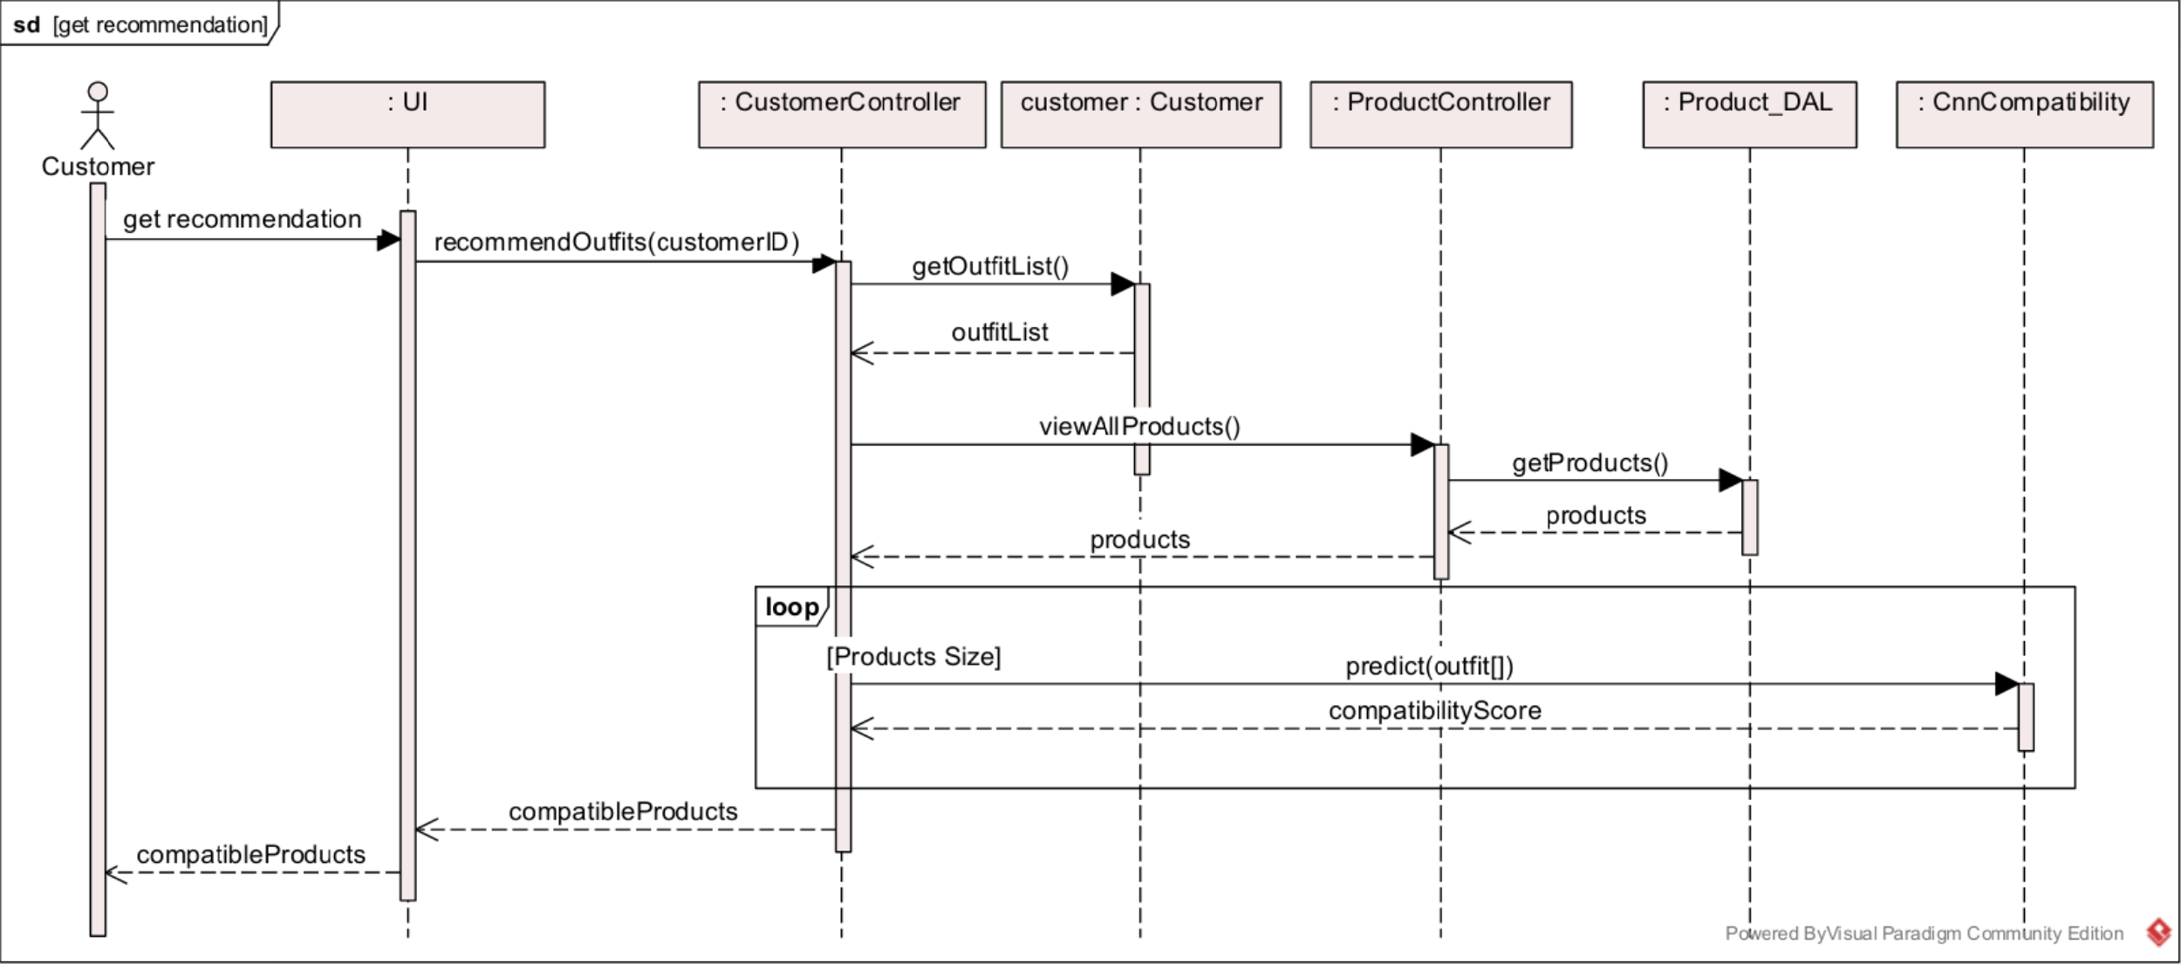
Sequence Diagram (Get Recommendation)

Slide 26
04
Time Plan

Slide 27
Gantt Chart

Slide 28
05
Conclusion

Slide 29
Conclusion
All people like to look good and dress nicely.
Brands and shop owners like to increase their profit and have more exposure.
Parfait fit will satisfy both of their needs:
Become an on-hand stylist for the customers.
Advertise the brands, recommend their items to customers.
By using CNN, deep learning, Django and flutter to build this system for the users.

Slide 30
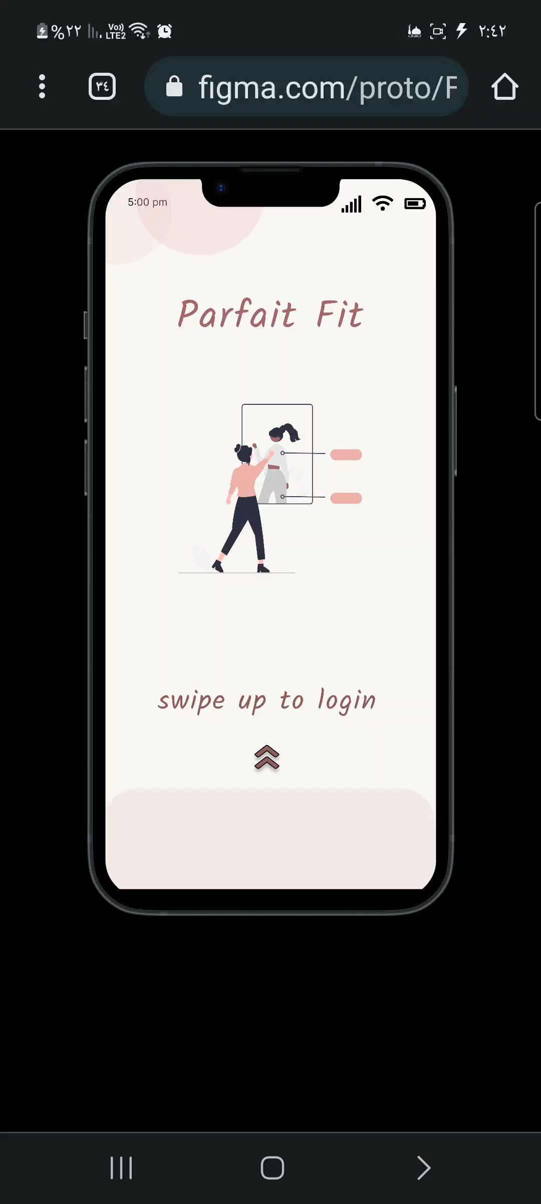
Demo
[For Customers]

Slide 31
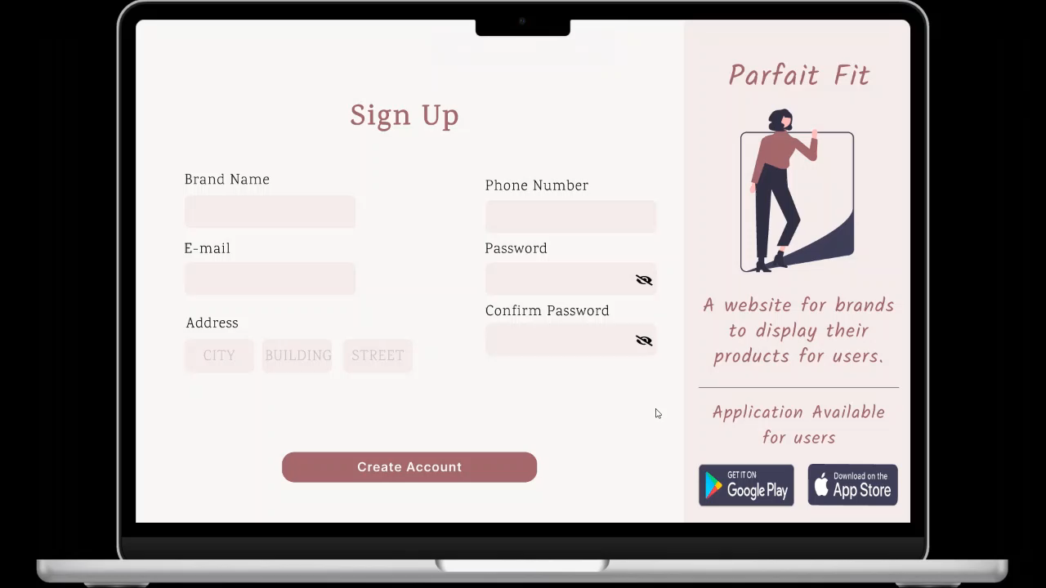
Demo
[For Providers
and Admin]

Slide 32
THANK YOU
DO YOU HAVE ANY QUESTIONS?

